Slide 1

SQL
Advanced SQL functions

Slide 2
What is Recursive CTE & its uses
A Recursive CTE (Common Table Expression) is a type of CTE in SQL that references itself to perform iterative or hierarchical operations. It allows you to generate a result set that builds upon its previous rows, enabling you to:
Traverse hierarchical data (e.g., employee-manager relationships, folder structures, category trees).
Generate sequences (numbers, dates).
Flatten parent-child relationships into a denormalized format.
A recursive CTE consists of two parts:
Anchor member – the initial query that produces the starting row(s).
Recursive member – a query that references the CTE itself to produce additional rows.
The recursion continues until a termination condition is met.
Notes:
A recursive CTE is a way for SQL to build results step by step,
where each step uses the output from the previous step,
until a defined stopping point is reached.
We can think of anour organizational chart. You start with the MD, then list Directors reports, then the next level of EM managers, and so on. You keep expanding level by level until there are no more employees to add. A recursive CTE works in the same way.
Reporting hierarchies
Product categories
Customer relationships
Approval workflows

Slide 3
Recursive CTE Query Syntax
WITH RECURSIVE query_name (Field1, Field2, ...) AS (
-- Anchor query: initializes the sequence
SELECT <initial values>
UNION ALL -- Combines anchor query with the recursive query
-- Recursive query: refers to the CTE itself
SELECT <expression using query_name>
FROM query_name
WHERE <termination condition> -- stops recursion
)
SELECT *
FROM query_name;

Slide 4
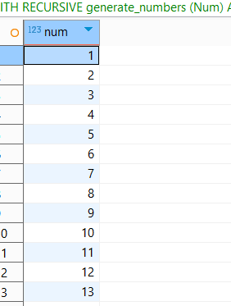
Recursive CTE Query -Generate Numbers
WITH RECURSIVE generate_numbers (Num) AS (
SELECT 1 AS Num -- Anchor query: initializes the sequence
UNION ALL -- Combines anchor query with the recursive query
SELECT Num + 1 -- Recursive query: increments the number by 1
FROM generate_numbers -- References the CTE itself
WHERE Num <= 99 -- Termination condition: stops recursion after 99
)
SELECT *
FROM generate_numbers;

Slide 5
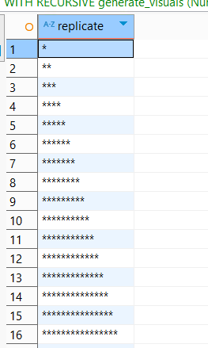
Recursive CTE Query -Generate Visuals
WITH RECURSIVE generate_visuals (Num) AS (
SELECT 1 AS Num -- Anchor query: initializes the sequence
UNION ALL -- Combines anchor query with the recursive query
SELECT Num + 1 -- Recursive query: increments the number by 1
FROM generate_visuals -- References the CTE itself
WHERE Num <= 99
-- Termination condition: stops recursion after 99
)
SELECT replicate('*',Num)
FROM generate_visuals;

Slide 6
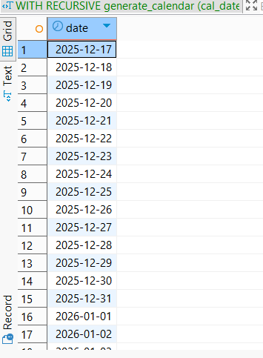
Recursive CTE Query -Generate Calendar
WITH RECURSIVE generate_calendar (cal_date) AS (
-- Anchor query: start with today’s date
SELECT getdate()::date AS cal_date
UNION ALL
-- Recursive query: add 1 day each time
SELECT dateadd(day, 1, cal_date)::date
FROM generate_calendar
-- Termination condition: stop after 365 days from today
WHERE cal_date < dateadd(day, 365, getdate()::date)
)
SELECT cal_date AS date
FROM generate_calendar
ORDER BY cal_date ASC;

Slide 7
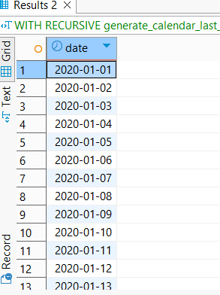
Recursive CTE Query -Generate Calendar for last 5 years
WITH RECURSIVE generate_calendar_last_five_years (cal_date) AS (
-- Anchor query: start from Jan 1, five years ago
SELECT dateadd(year,-5, date_trunc('year', getdate()::date))::date AS cal_date
UNION ALL
-- Recursive query: add 1 day
SELECT dateadd(day, 1, cal_date)::date
FROM generate_calendar_last_five_years
-- Termination condition: stop at Jan 1 of next year
WHERE cal_date < dateadd(year,1,date_trunc('year', getdate()::date))::date
)
SELECT cal_date AS date
FROM generate_calendar_last_five_years
ORDER BY cal_date ASC;

Slide 8
Recursive CTE Query –Hierarchy Part 1
WITH RECURSIVE employees_cte1 (emp_id, emp_name, manager_id, level, path)
AS (-- Base data
SELECT 1 AS emp_id, 'CEO' AS emp_name, NULL AS manager_id, NULL::INT AS level, NULL::VARCHAR(1000) AS path
UNION all SELECT 2, 'VP Sales', 1, NULL::INT, NULL::VARCHAR(1000)
UNION ALL SELECT 3, 'VP Technology', 1, NULL::INT, NULL::VARCHAR(1000)
UNION ALL SELECT 4, 'Sales Manager', 2, NULL::INT, NULL::VARCHAR(1000)
UNION ALL SELECT 5, 'Tech Manager', 3, NULL::INT, NULL::VARCHAR(1000)
UNION ALL SELECT 6, 'Sales Executive', 4, NULL::INT, NULL::VARCHAR(1000)
UNION ALL SELECT 7, 'Developer', 5, NULL::INT, NULL::VARCHAR(1000)
UNION ALL SELECT 8, 'Intern', 7, NULL::INT, NULL::VARCHAR(1000)
),

Slide 9
Recursive CTE Query –Hierarchy Part 2
emp_hierarchy (emp_id, emp_name, manager_id, level, path)
AS (-- Anchor member: top-level managers
SELECT emp_id, emp_name, manager_id, 0 as level, emp_name::VARCHAR(100) as path
FROM employees_cte1
WHERE manager_id IS NULL
UNION ALL
-- Recursive member: employees reporting to previous level
SELECT e.emp_id, e.emp_name, e.manager_id, eh.level + 1, (eh.path || ' → ' || e.emp_name)::VARCHAR(1000)
FROM employees_cte1 e
JOIN emp_hierarchy eh
ON e.manager_id = eh.emp_id
)-- Select from the recursive hierarchy, not the base CTE
SELECT *
FROM emp_hierarchy
ORDER BY level, emp_id;

Slide 10
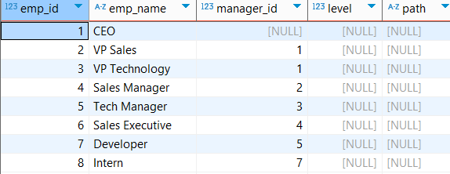
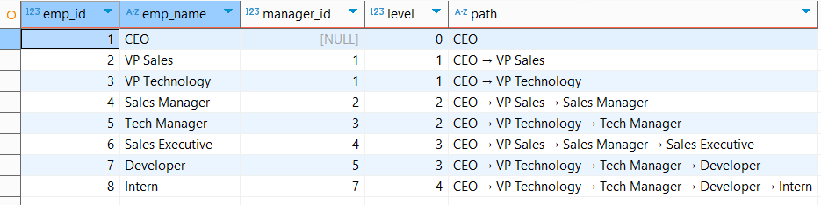
Recursive CTE Query –Hierarchy Output

Slide 11
Looping Statements in SQL
SQL supports four main looping constructs:
LOOP
WHILE LOOP
FOR LOOP (Number)
FOR LOOP (Query based)
These are used inside functions, procedures, or DO blocks.

Slide 12
Looping Statements - Basics
PL/pgSQL: SQL + Programming Logic
SQL → Structured Query Language
Used for set-based operations (SELECT, INSERT, UPDATE, DELETE).
PL → Procedural Language
Adds procedural programming features like:
Variables
Loops
Conditions (IF, CASE)
Cursors
Exception handling
Functions &
Procedures
SQL statements are sent to the SQL Engine. Procedural code is handled by the PL/SQL Engine Both engines communicate each other

Slide 13
Looping Statements - Basics
DO: DO executes an anonymous code block in PostgreSQL. Used when you don’t want to create a permanent function Useful for testing, one-time scripts, and ad-hoc loops
DECLARE is where you define variables, cursors, and constants. Example:
DECLARE
counter INT := 1;
total INT;
$$ (Dollar Quoting) $$ is a delimiter that tells PostgreSQL where the code block starts and ends
DO $$ ... $$;
DO $body$ ... $body$;
BEGIN : Marks the start of executable code.
END: Marks the end of the executable block.

Slide 14
Looping Statements - Basics
LOOP: Starts a repeating block of code.
END LOOP: Closes the LOOP block.
RAISE NOTICE: Prints a message to the console/output.
% is a placeholder
Example: RAISE NOTICE 'Current value: %', i;
CALL: executing the stored proceduce
LANGUAGE:
specifies which language the database should use to run your code.
plpgsql is PostgreSQL’s procedural extension of SQL: Allows variables, loops, IF conditions, error handlingEnables procedures and functions to be more than just single SQL statements
Notes:
We should mention LANGUAGE plpgsql in your procedure or function because it tells PostgreSQL what procedural language to use to interpret the code.

Slide 15
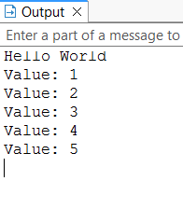
LOOP Syntax
LOOP
statements;
EXIT WHEN condition;
END LOOP;
Example:
CREATE OR REPLACE PROCEDURE print_integers()
LANGUAGE plpgsql
AS $$
DECLARE
i INT := 1;
BEGIN
LOOP
RAISE NOTICE 'Value: %', i;
i := i + 1;
EXIT WHEN i > 5;
END LOOP;
END;
$$;

Slide 16
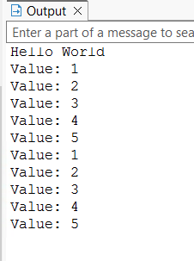
While Loop
WHILE condition LOOP
statements;
END LOOP;
Example:
CREATE OR REPLACE PROCEDURE print_integers_1()
LANGUAGE plpgsql
AS $$
DECLARE
i INT := 1;
BEGIN
WHILE i <= 5 LOOP
RAISE NOTICE 'Value: %', i;
i := i + 1;
END LOOP;
END;
$$;
call print_integers_1()

Slide 17
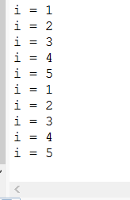
For Loop (Numeric)
FOR counter IN start..end LOOP
statements;
END LOOP;
Example:
CREATE OR REPLACE PROCEDURE print_integers_2()
LANGUAGE plpgsql
AS $$
BEGIN
FOR i IN 1..5 LOOP
RAISE NOTICE 'i = %', i;
END LOOP;
END;
$$;
call print_integers_2()

Slide 18
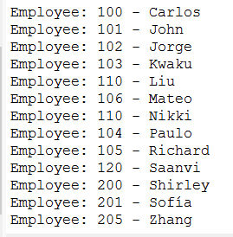
For Loop (Query)
FOR record_variable IN query LOOP
statements;
END LOOP;
CREATE OR REPLACE PROCEDURE print_records()
LANGUAGE plpgsql
AS $$
DECLARE
rec RECORD;
BEGIN
FOR rec IN
SELECT id, name FROM
db_analytics.anantharaj.employee
LOOP
RAISE NOTICE 'Employee: % - %', rec.id, rec.name;
END LOOP;
END;
$$;
call print_records()

Slide 19
Thank you

